Slide 1

Information Security
Dr. Qaisar Javaid

Slide 2
Course Material
Reference books
  No single textbook covers the whole course!
Lot of research papers!
  Many will be made available on course web site
RFCs and Internet drafts
  Related to network security protocols
Web resources
  Tutorials, white papers, reports, etc.

Slide 3
Course Information
Pre-requisites
  Computer Networks course
    You are assumed to have good knowledge of TCP/IP protocol suite
  Operating Systems
  Basic understanding of programming languages
Class assessment by four assignments, three projects, a mid-term and a final exam
  May be one extra assignment and/or project

Slide 4
Course Contents
Introduction to network security
I. CRYPTOGRAPHY
  Symmetric Encryption and Message Confidentiality
  Public-Key Cryptography and Message Authentication
II. NETWORK SECURITY APPLICATIONS
  Authentication Applications (Kerberos, X.509)
  Electronic Mail Security (PGP, S/MIME)
  IP Security (IPSec, AH, ESP, IKE)
  Web Security (SSL, TLS, SET)
  Network Management Security (SNMP)

Slide 5
Course Contents
III. SYSTEM SECURITY
  Intruders and intrusion detection
  Malicious Software (viruses)
  Firewalls and trusted systems
IV. Operating System and File System Security
  Approximately 4 lectures
  Covered by Mr Farhan Zaidi

Slide 6
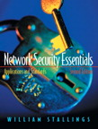

Textbooks
One of the following three books is required for this course:
William Stallings, Network Security Essentials, 2/E
  One or two chapters from CNS3e
William Stallings, Cryptography and Network Security: Principles and Practice, 3/E
  Network management security from NSE2e

Slide 7
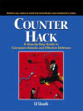
Textbooks
C Kaufman, R Perlman, M Speciner, Network Security: Private Communication in a Public World
  Detail of course contents
Ed Skoudis, Counter Hack: A Step by Step Guide to Computer Attacks and Defenses
  Some Chapters from this book

Slide 8
Expectations
What do you want (or expect) to learn from
this class ?

Slide 9
Expectations
This class IS about …
  Network security principles and concepts
  Overview of cryptography, its use, principles and major algorithms
  Message authentication and encryption techniques
  Security of network “system”
  Operating system security
  Security practices and applications

Slide 10
Expectations
This class IS NOT about …
  Details of cryptographic algorithms
  Survey of existing protocol standards
  Survey of loopholes in current protocols
  How to hack the network of CASE!
  Tools and tips to breach Internet security
  How you can become a good hacker …

Slide 11
Expectations
We will learn
Why and How
networks are made secure

Slide 12
Outline
Attacks, services and mechanisms
Security attacks
Security services
Methods of Defense
A model for Internetwork Security
Internet standards and RFCs

Slide 13
Definitions
Computer Security - generic name for the collection of tools designed to protect data and to thwart hackers
Network Security - measures to protect data during their transmission
Internet Security - measures to protect data during their transmission over a collection of interconnected networks

Slide 14
Aim of this Course
Our emphasis is on internet security
Consists of measures to deter, prevent, detect, and correct security violations that involve the transmission of information
Requirements seem straightforward, but the mechanisms used to meet them can be quite complex …

Slide 15
Services, Mechanisms, Attacks
Need systematic way to define requirements
Consider three aspects of information security:
  security attack
  security mechanism
  security service
Consider in reverse order

Slide 16
Security Service
Is something that enhances the security of the data processing systems and the information transfers of an organization
Intended to counter security attacks
Make use of one or more security mechanisms to provide the service
Replicate functions normally associated with physical documents e.g.
  have signatures or dates
  need protection from disclosure, tampering, or destruction
  be notarized or witnessed
  be recorded or licensed

Slide 17
Security Mechanism
A mechanism that is designed to detect, prevent, or recover from a security attack
No single mechanism that will support all functions required
However one particular element underlies many of the security mechanisms in use: cryptographic techniques
Hence our review of this area

Slide 18
Security Attack
Any action that compromises the security of information owned by an organization
Information security is about how to prevent attacks, or failing that, to detect attacks on information-based systems
Have a wide range of attacks
Can focus on generic types of attacks
  Note: often threat & attack mean same
Notes:
cf. Table 1.2 for examples of security attacks, and Table 1.3 for definitions of threat and attack

Slide 19
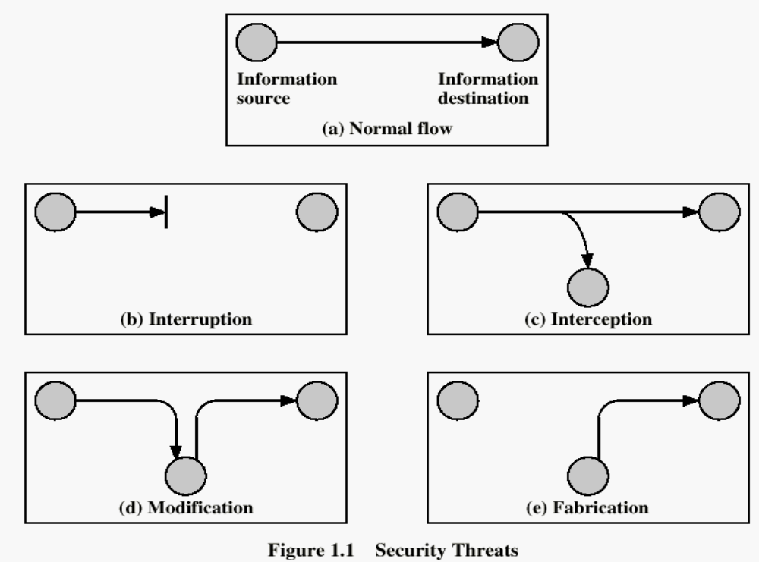
Security Attacks

Slide 20
Security Attacks
Interruption: This is an attack on availability
Interception: This is an attack on confidentiality
Modification: This is an attack on integrity
Fabrication: This is an attack on authenticity

Slide 21
Security Goals
Confidentiality
Integrity
Availability

Slide 22
Summary: Attacks, Services and Mechanisms
Security Attack: Any action that compromises the security of information.
Security Mechanism: A mechanism that is designed to detect, prevent, or recover from a security attack.
Security Service: A service that enhances the security of data processing systems and information transfers. A security service makes use of one or more security mechanisms.

Slide 23
Security Services
Confidentiality (privacy)
Authentication (who created or sent the data)
Integrity (has not been altered)
Non-repudiation (the order is final)
Access control (prevent misuse of resources)
Availability (permanence, non-erasure)
  Denial of Service Attacks
  Virus that deletes files

Slide 24
Classify Security Attacks as
Passive attacks - eavesdropping on, or monitoring of, transmissions to:
  obtain message contents, or
  monitor traffic flows
Active attacks – modification of data stream to:
  masquerade of one entity as some other
  replay previous messages
  modify messages in transit
  denial of service

Slide 25
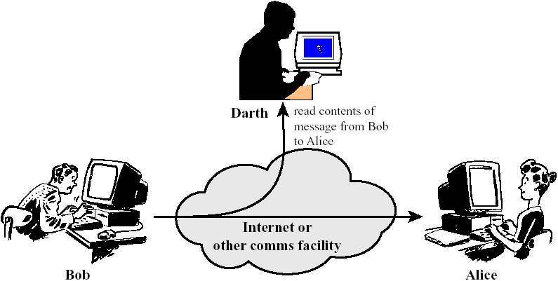
Passive Attacks: Release of Message Contents

Slide 26
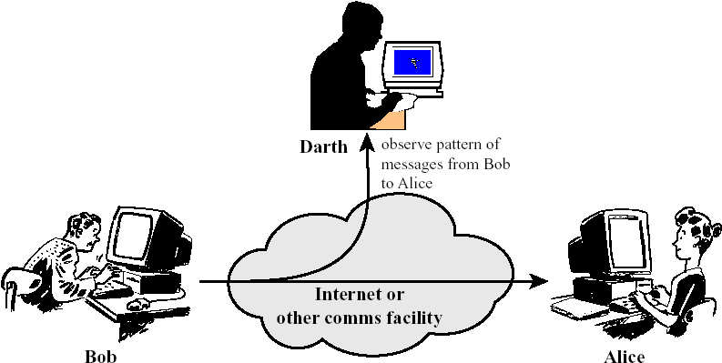
Passive Attacks: Traffic Analysis

Slide 27
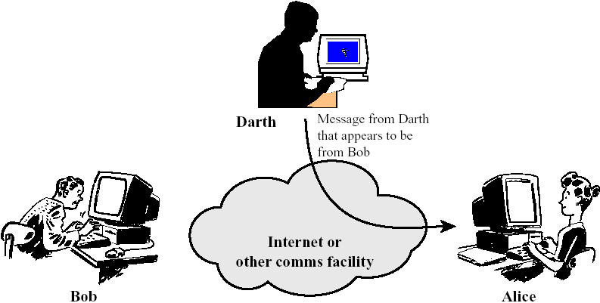
Active Attacks: Masquerade

Slide 28
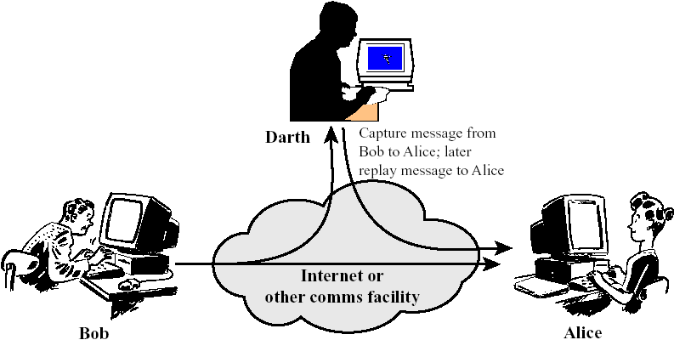
Active Attacks: Replay

Slide 29
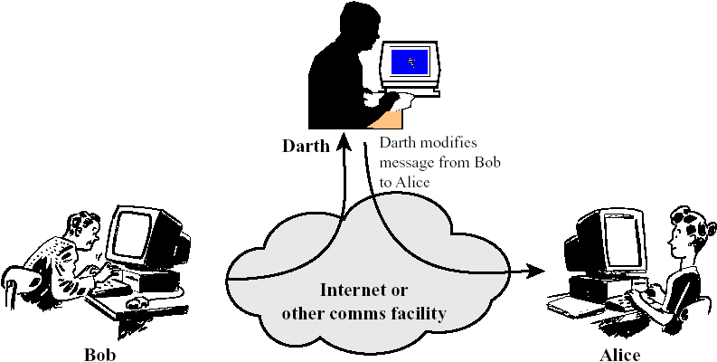
Active Attacks: Modification of Messages

Slide 30
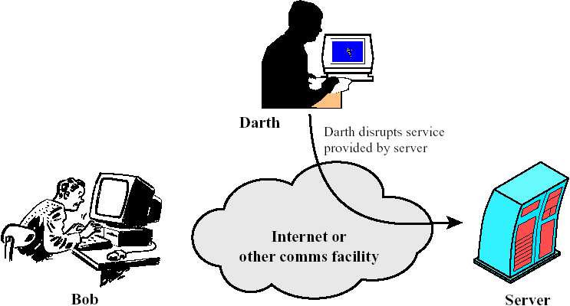
Active Attacks: Denial of Service

Slide 31
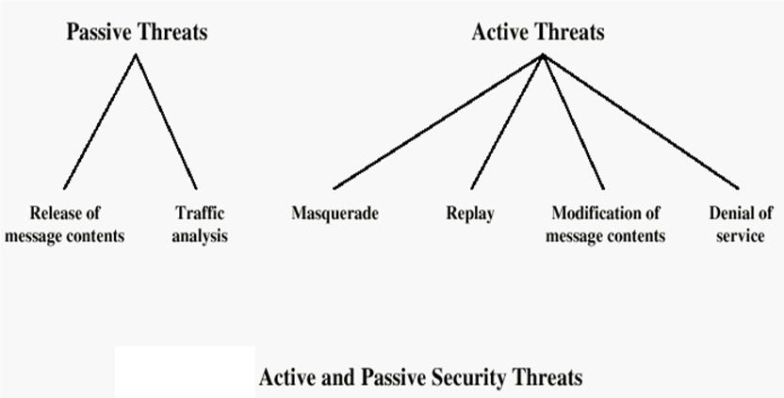

Slide 32

Model for Network Security
Notes:
In considering the place of encryption, its useful to use the following two models. The first models information flowing over an insecure communications channel, in the presence of possible opponents. Hence an appropriate security transform (encryption algorithm) can be used, with suitable keys, possibly negotiated using the presence of a trusted third party.

Slide 33
Model for Network Security
Using this model requires us to:
  design a suitable algorithm for the security transformation
  generate the secret information (keys) used by the algorithm
  develop methods to distribute and share the secret information
  specify a protocol enabling the principals to use the transformation and secret information for a security service

Slide 34
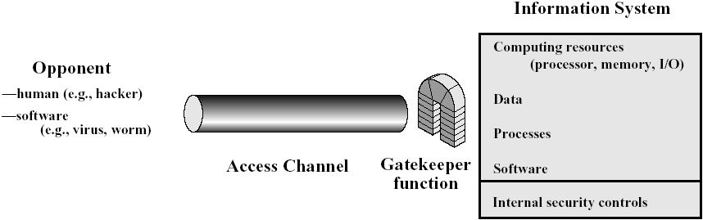
Model for Network Access Security
Notes:
The second model is concerned with controlled access to information or resources on a computer system, in the presence of possible opponents. Here appropriate controls are needed on the access and within the system, to provide suitable security. Some cryptographic techniques are useful here also.

Slide 35
Model for Network Access Security
Using this model requires us to:
  select appropriate gatekeeper functions to identify users
  implement security controls to ensure only authorised users access designated information or resources
Trusted computer systems can be used to implement this model

Slide 36
Methods of Defense
Encryption
Software Controls (access limitations in a data base, in operating system protect each user from other users)
Hardware Controls (smartcard)
Policies (frequent changes of passwords)
Physical Controls

Slide 37
Internet standards and RFCs
The Internet society
  Internet Architecture Board (IAB)
  Internet Engineering Task Force (IETF)
  Internet Engineering Steering Group (IESG)

Slide 38
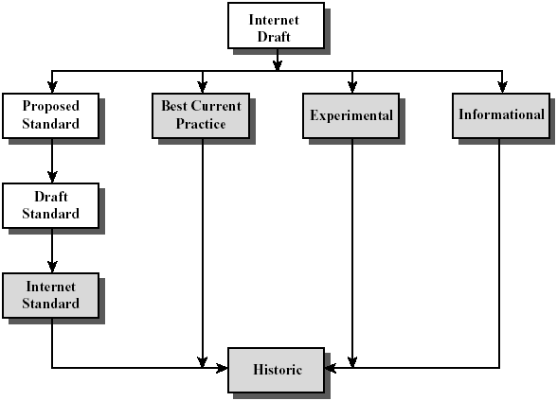
Internet RFC Publication Process

Slide 39
Summary
Have considered:
  computer, network, internet security def’s
  security services, mechanisms, attacks
  X.800 standard
  models for network (access) security

